Slide 1
CHAPTER 2
BE STYLED WITH CSS

Slide 2

OBJECTIVES FOR TODAY
What is a CSS rule ?
Create your CSS rules to add color, fonts, borders to your ugly HTML!

Slide 3

REVIEW
Back to
homework…

Slide 4
REVIEW
HTML code is composed of elements
<tagname>content</tagname>
Start tag
End tag

Slide 5
REVIEW
HTML code is composed of elements
<tagname attribute=“value”/>
Start tag
End tag

Slide 6
REVIEW
How many HTML elements do you know ?

Slide 7
REVIEW
<ul>
<ol>
<li>
<q>
<h1>
How many HTML elements do you know ?
<b>
<body>
<br>
<head>
<img>
<p>

Slide 8
REVIEW
HTML elements can be nested
<p> <p> Hello </p> </p>

Slide 9
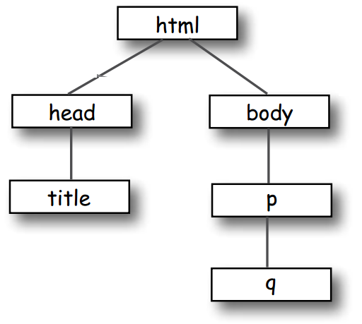
REVIEW
Nested elements graph
<html>
<head>
<title>Musings</title>
</head>
<body>
<p>
To quote Buckaroo,
<q>The only reason
for time is so
that everything
doesn’t happen
at once.</q>
</p>
</body>
</html>

Slide 10


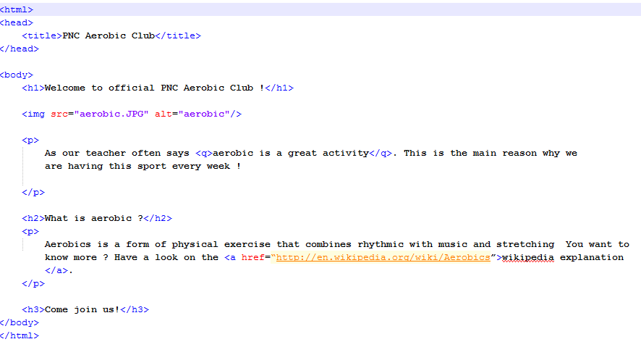
PRACTICE
10 MIN
INDIV
Draw nested elements graph

Slide 11

REVIEW
Draw nested elements graph
5 MIN
CLASS
html
head
body
title
h1
img
p
h1
p
h3
q
a

Slide 12

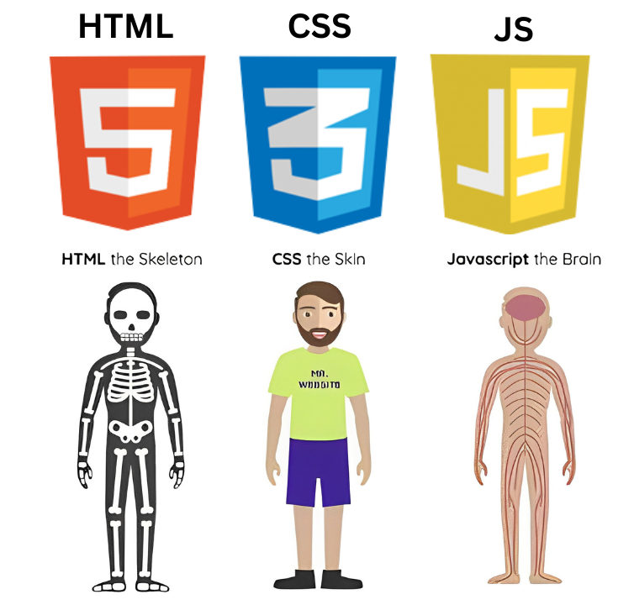
DEMO
CSS makes the life more beautiful
5 MIN
CLASS
Notes:
Open the link and during the demo, remove the CSS style to show the effect of HTML alone

Slide 13
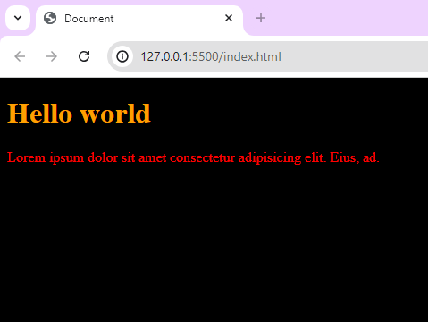
EXPLAIN
Let’s decorate code
A CSS Syntax rule consists of a selector, property, and its value
body{
background: black;
}
h1 {
color : blue;
}
P{
Color: Red;
}

Slide 14
EXPLAIN
Write you first rule in CSS
There is a
colon here
There is a semi-colon at the end
p {
color : red;
}
Specify the property you want to style
Set the color of paragraph in red
Select the element you want to style

Slide 15
PRACTICE
Add your CSS code to your HTML page
5 MIN
INDIV
<head>
<style>
p { background-color: red; }
<style>
</head>
Inside the <style> HTML element, you write in CSS code !

Slide 16
EXPLAIN
3 ways to set your CSS style
INLINE :
I white CSS inside the tag inside the HTML file
<h1 style="color:blue; font-size:14px;">This is my title</h1>
BLOCK / Internal CSS :
use the tag <style> inside my HTML file, inside <head>
<head>
<style> h1 {color:blue; font-size:14px;} </style>
</head>
EXTERNAL :
I use an other file : style.css

Slide 17
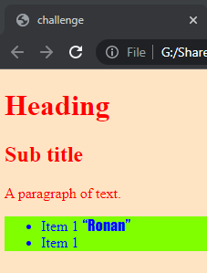
PRACTICE
p {
color : red;
}
20 MIN
2
Group of 2
Check CSS documentation on the WEB: http://www.w3schools.com/cssref/
Write your code in 2 separate files (external method)
Explain your results to others
Background color = bisque
h1
h2
HELP
<head>
<link rel="stylesheet" href="stylesheet.css">
</head>
Quote +
Font family = fantasy
Background color = chartreuse
Notes:
Here, show how to start, create CSS file in a other folder and show how to link HTML to CSS

Slide 18
PRACTICE
Let’s learn the internal methods
10 MIN
INDIV
Get the folder aerobic and edit aerobic.html and fans.html
Add a style element to :
Display paragraphs in BLUE
Display H1 in RED
Display H2 in GREEN

Slide 19



EXPLORE
5 MIN
2
Can I display 2 paragraphs in different colors ?
Why do we need 2 languages ? We cannot do everything with HTML ?

Slide 20
EXPLORE
5 MIN
2
How can we know the list of all CSS properties ?
http://www.w3schools.com/cssref/
p { color : red; }
value
property
element

Slide 21
NOW YOU KNOW
What is a CSS rule ?
Create your CSS rules to add color, fonts, borders to your ugly HTML!

Slide 22

HOMEWORK
INDIV
After class what to do ?
1. Read the handout I give you now.
2. Do the required homework
3. Send your homework to Google Classroom

